Slide 1

23AID305 – CONTROL SYSTEM Review 0
Learning-Based Model Predictive Control for Multi-Room Energy Incident Management in
Smart Hospitals Using Cloud Services
Team 9 :
Gowtham SD : CB.AI.U4AID23113
Guhan K B : CB.AI.U4AID23114
Vaishnavi Gupta : CB.AI.U4AID23149
Vyshnav Kumar S : CB.AI.U4AID23151

Slide 2
Contents
Introduction
Literature survey
Research gap
Problem statement
Objective
Terminologies
Methodology
Tools used
Timeline
References

Slide 3
Introduction
Hospitals require reliable energy and thermal management to maintain patient safety and comfort.
Traditional systems lack adaptability, prioritization, and cloud-based remote access.
This project uses Learning-Based Model Predictive Control (LB-MPC) to manage HVAC across multiple hospital zones.
Real-time data is sent to the cloud for monitoring, visualization, and remote updates, ensuring intelligent and scalable control.

Slide 4
Literature survey
S.no | Paper Title | Year | Methodology | Key Contributions
1 | A Learning-Based Model Predictive Control Strategy for Home Energy Management Systems | 2023 | Learning-Based Model Predictive Control (LBMPC) for Home Energy Management Systems (HEMS). It combines a physics-based thermal model, an online learning module, and MPC to minimize energy cost while maintaining thermal comfort. Results show that LBMPC achieves lower energy use and better temperature control than traditional MPC. | LBMPC framework integrating learning and control for adaptive energy management. Enhanced comfort and energy efficiency through accurate prediction and control. Simulation-based validation showing effectiveness over traditional MPC.
2 | Adaptive Model Predictive Controller for Building Thermal Dynamics | 2024 | The paper proposes an Adaptive Model Predictive Control (AMPC) for building thermal dynamics, using online parameter estimation to update the thermal model in real-time. This allows MPC to adapt to changes like occupancy and weather. Results show improved temperature control and lower energy use compared to traditional MPC and rule-based methods. | Development of an adaptive MPC framework for building climate control. Use of online thermal model identification to handle system variability. Increased robustness under uncertain and dynamic building conditions.

Slide 5
3 | Installation and Testing of a Two-Level Model Predictive Control Building Energy Management System | 2024 | Two-level MPC (MPC1 for load, MPC2 for storage); tested on MSASS building with PV and ESS. Results showed: successful power trajectory tracking, effective SoC prediction, and PV forecasting error correction via “ES Trim”. | Demonstrated a scalable, practical system using COTS tech for energy efficiency, demand response, and grid interaction in smart buildings.
4 | A Distributionally Robust MPC for Static and Dynamic Uncertainties in Smart Grids | 2024 | WDR-MPC using a two-stage approach: constructs ambiguity tubes for dynamic uncertainties and convex reformulations for static ones. Results: achieved near-100% constraint satisfaction across 5000 out-of-sample tests, reduced operational cost. | Pioneered a unified MPC framework that simultaneously addresses both static (RES forecast errors) and dynamic (PEV charging behavior) uncertainties; scalable and reliable for real-time smart grid control.
5 | Controlling a House’s Air-Conditioning Using Nonlinear Model Predictive Control | 2024 | The paper proposes a Nonlinear Model Predictive Control (NMPC) strategy for residential air-conditioning. It uses a nonlinear thermal model of the house to predict and optimize indoor temperature control. Results show that NMPC provides better temperature regulation and energy efficiency than conventional control methods. | Application of NMPC to residential air-conditioning systems. Use of a nonlinear house model to capture realistic thermal dynamics. Demonstrated improved comfort and energy savings over standard controllers.

Slide 6
6 | Flexible Building Energy Management With Neural ODEs-Based Model Predictive Control | 2024 | Neural ODE-based gray-box thermal model embedded in linear MPC; compared with four other models. Results: Model 1 achieved 1.8% better short-term and 39.3% better long-term prediction accuracy than the RC model; achieved 45.1% total energy cost reduction. The proposed model has the lowest computational time among all other evaluated models. | Introduced Neural ODEs to model building thermodynamics, achieving high accuracy and low computation time. Enabled effective DR and energy hub integration.
7 | Priority-Based Energy Allocation in Buildings Through Distributed Model Predictive Control | 2025 | Distributed MPC with priority-based allocation (1-to-1 and multi-to-1). Simulations on 3-zone and 36-zone buildings. Results: Matched centralized performance with much lower computation; scalable for large systems under energy-constrained scenarios. | Developed distributed energy control respecting zone priorities; enabled scalable, real-time allocation with EnergyPlus+ MATLAB co-simulation.
8 | Temperature Control of a Commercial Building With Model Predictive Control Techniques | 2015 | The paper presents a Model Predictive Control (MPC) approach for temperature control in commercial buildings using a detailed thermal model and real-time optimization. Results show that MPC enhances energy efficiency and temperature stability compared to traditional rule-based systems. | Application of MPC to real-world commercial building HVAC control. Integration of a detailed thermal model with predictive optimization. Demonstrated energy savings and improved indoor comfort.

Slide 7
Research gap
No application in healthcare-critical environments
Absence of cloud-integrated MPC frameworks
Limited incident-aware or priority-based energy management
Minimal use of hybrid learning models in scalable multi-zone setups

Slide 8
Problem statement
Existing hospital EMS systems are limited by hardware dependency and lack priority-based energy allocation across critical zones.
Conventional MPC approaches rely on static or data-hungry models, reducing accuracy under dynamic conditions.
Current systems lack scalability and cloud-based intelligence needed for real-time, adaptive multi-room energy management.

Slide 9
Objective
Simulate real-time hospital energy demand across zones with different priorities.
Optimizes energy dispatch considering battery state-of-charge and grid limits.
Provides an interactive, dashboard for remote control and monitoring.
Operates fully in the cloud without hardware dependencies.

Slide 10
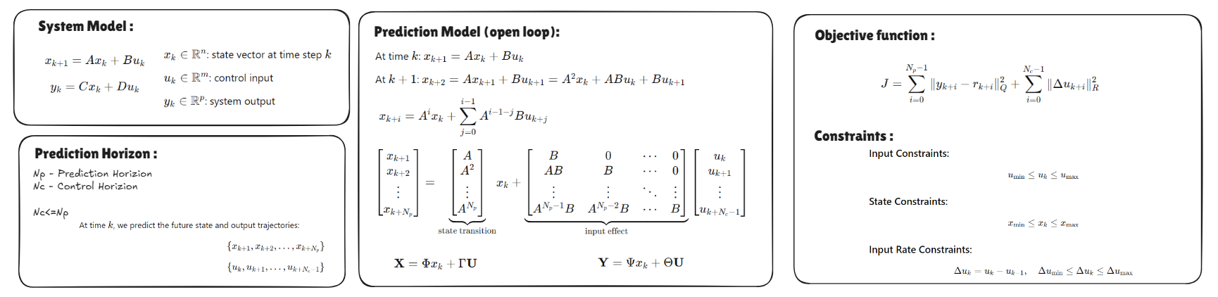
Model PREDICTIVE CONTROL
Model Predictive Control (MPC) is an advanced control strategy widely used in engineering systems where performance, constraints, and future behavior matter. It’s especially powerful for multi-variable, constrained, and predictive control problems , basically an optimization problem to find the best input.

Slide 11

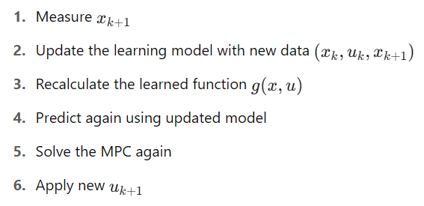
Learning BASED - MPC
Learning-Based Model Predictive Control (LB-MPC) is a modern extension of MPC that integrates machine learning techniques into the traditional Model Predictive Control framework to improve performance under uncertain or known system dynamics.
Here the learned error helps in capturing non-linearities/uncertainities.

Slide 12
Methodology
1. Thermal and Electrical Modeling of Hospital Zones
Develop RC thermal models for individual hospital rooms.
Simulate temperature variations and HVAC-driven energy usage.
Incorporate electrical load profiles for each room based on lighting, equipment, and occupancy.
2. Power Grid and EMS Simulation
Model a power grid supplying energy to hospital zones and HVAC systems.
Simulate dynamic power constraints, renewable sources (optional), and faults.
Integrate an EMS block to monitor and manage room-level energy consumption.

Slide 13
Methodology
3. Data Acquisition Layer
Collect real-time data from sensors across hospital zones (temperature, power usage).
Gather grid status, load profiles, and HVAC system activity.
Send data to both the cloud and EMS block for control and analysis.
4. Forecasting Module
Predict ambient temperature and power availability using time-series models.
Feed predictions into the cloud to assist LB-MPC in disturbance-aware control.
Enable proactive decision-making under uncertain conditions.

Slide 14
Methodology
5. Cloud Integration
Act as a central hub for data storage, forecast distribution, and control coordination.
Log real-time system states and performance metrics.
Interface with the forecasting module and deliver inputs to the LB-MPC.
6. Learning-Based MPC (LB-MPC) Control
Optimize HVAC and energy control actions using forecast and real-time inputs.
Maintain thermal comfort while minimizing energy consumption and respecting grid limits.
Use reinforcement learning to adaptively improve control policy over time.

Slide 15
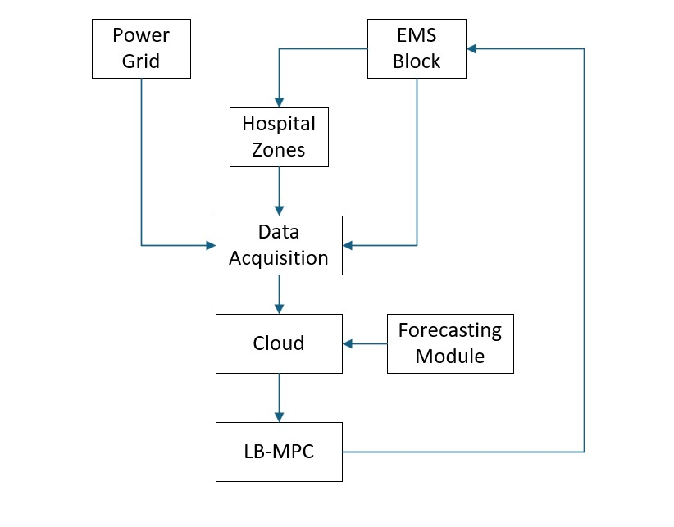
Flowchart

Slide 16
Tools to be Used
Matlab Simulink
SimScape Electrical
Mat Power
Python (TensorFlow)
ThingSpeak

Slide 17
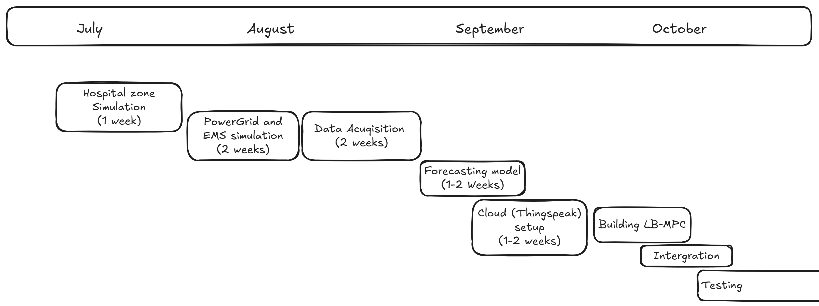
Timeline

Slide 18
References
H. Agharazi et al., "Installation and Testing of a Two-Level Model Predictive Control Building Energy Management System," in IEEE Transactions on Control Systems Technology, vol. 32, no. 2, pp. 326-339, March 2024
W. Cai, S. Sawant, D. Reinhardt, S. Rastegarpour and S. Gros, "A Learning-Based Model Predictive Control Strategy for Home Energy Management Systems," in IEEE Access, vol. 11, pp. 145264-145280, 2023
S. S. Tohidi, D. Calì and H. Madsen, "Adaptive Model Predictive Controller for Building Thermal Dynamics," in IEEE Control Systems Letters, vol. 8, pp. 1325-1330, 2024
B. He, N. Zhang, C. Fang, Y. Su and Y. Wang, "Flexible Building Energy Management With Neural ODEs-Based Model Predictive Control," in IEEE Transactions on Smart Grid, vol. 15, no. 5, pp. 4690-4704, Sept. 2024
H. Li, J. Xu and Q. Zhao, "Priority-Based Energy Allocation in Buildings Through Distributed Model Predictive Control," in IEEE Transactions on Automation Science and Engineering, vol. 22, pp. 7516-7529, 2025
B. K. Oleiwi and A. H. Sabry, "Controlling a House’s Air-Conditioning Using Nonlinear Model Predictive Control," in IEEE Embedded Systems Letters, vol. 16, no. 2, pp. 239-242, June 2024
G. Mantovani and L. Ferrarini, "Temperature Control of a Commercial Building With Model Predictive Control Techniques," in IEEE Transactions on Industrial Electronics, vol. 62, no. 4, pp. 2651-2660, April 2015
A. Martinčević and M. Vašak, "Constrained Kalman Filter for Identification of Semiphysical Building Thermal Models," in IEEE Transactions on Control Systems Technology, vol. 28, no. 6, pp. 2697-2704, Nov. 2020

